Slide 1

WEATHER APPLICATION

Slide 2
TEAM ID: LTVIP2023TMID08235
Kakinada Rishitha Priya (21NM5A0408) - Team Leader
Gorle Chandini (21NM5A0406)
Ommi Sandhya (20NM1A04C2)
Nandavarapu Shyam Sushmita Rani (20NM1A04B6)

Slide 3
PROJECT OBJECTIVES
Create a user interface using HTML and CSS to display weather information.
Utilize JavaScript to interact with the OpenWeatherMap API and fetch weather data.
Dynamically update the UI with the fetched weather data.
Allow users to search for weather information by city name.

Slide 4
PROBLEM STATEMENT
Creating a Weather app that provides real-time weather information for a Specified location.
It is implemented using HTML,CSS,JavaScript

Slide 5

HOW THIS WORKS: In this app don’t need to setup a weather station in each city on each country to get weather information including Temperature, Pressure, Humidity, Weather status by using Weather API

Slide 6
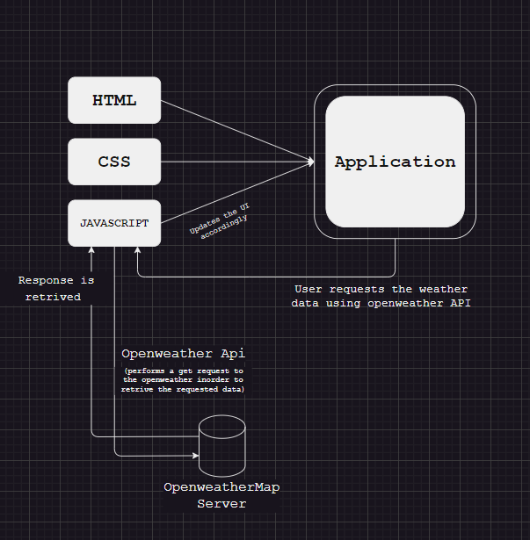
PROJECT STRUCTURE

Slide 7
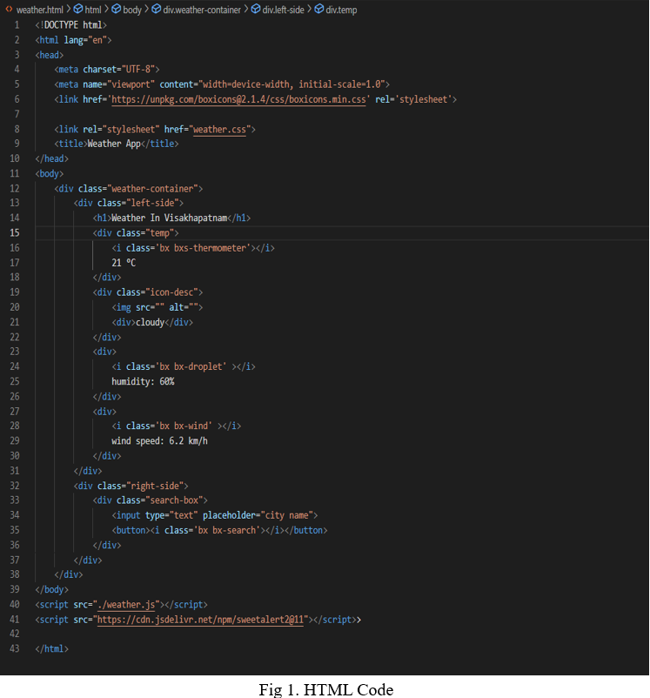
CREATING MODEL OF WEBPAGE USING HTML5

Slide 8
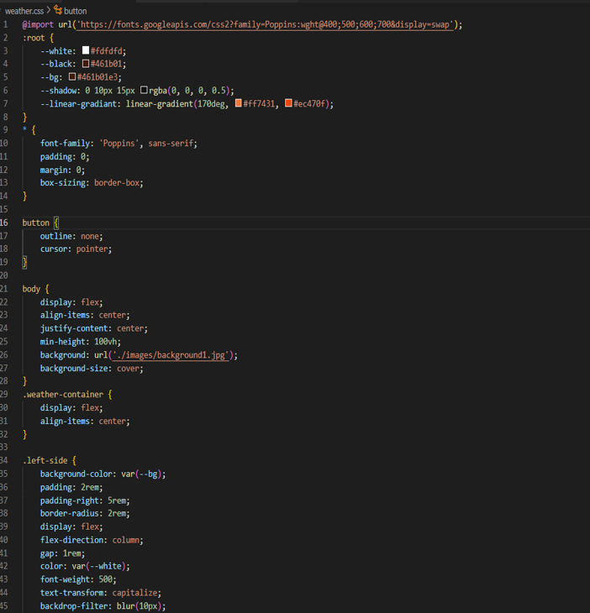
ADDING EFFECTS AND BACKGROUND USING CSS

Slide 9
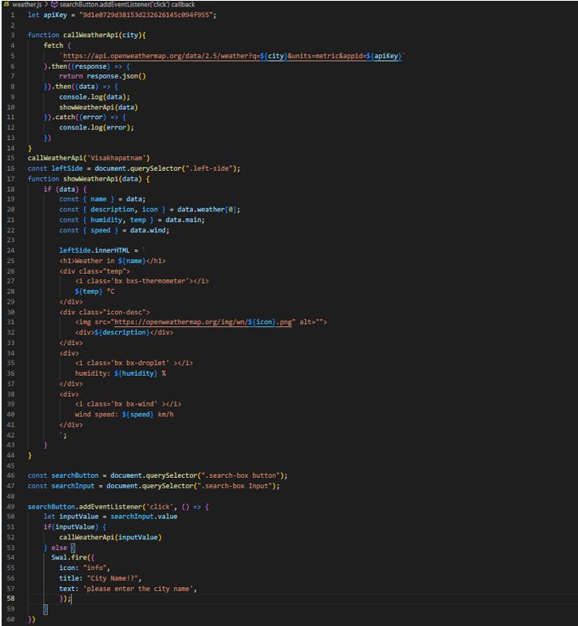
JS PERFORMS THE INTERACTIVE OPERATIONS

Slide 10
WHO ARE THE END USERS?
Buisness : Retailers such as local grocery stores, use short-term weather information, particularly about winter weather events.
Urban Design : Urban planners use meteorological information to assist in the development of climate change mitigation and adaption strategies of cities.
Environmental Regulation : Environmental protection agencies at federal, state, and local levels use meteorological information to monitor, regulate, and set standards for the protection of human health and the environment.

Slide 11
Local Government : Country officials, educators, and school superintendants use meteorological information to make decisions about closing schools during winter weather and convective weather events.
Personal Decision : Support The general public makes personal decisions (e.g., weekend activities, outdoor recreation, wedding planning) in daily life.
Research : Basic and applied researchers use meteorological information to conduct research in the various fields discussed in this report.

Slide 12
MODELLING
HTML5: By using html5 we created the model or structure of the webpage.
CSS: Added special effects and colored background based on the theme of the project which made it look even more attractive.
JavaScript: This made the webpage more interactive by performing the operations and giving soul to the web page portfolio. We have inserted home, achievements, interns and many interactive buttons

Slide 13
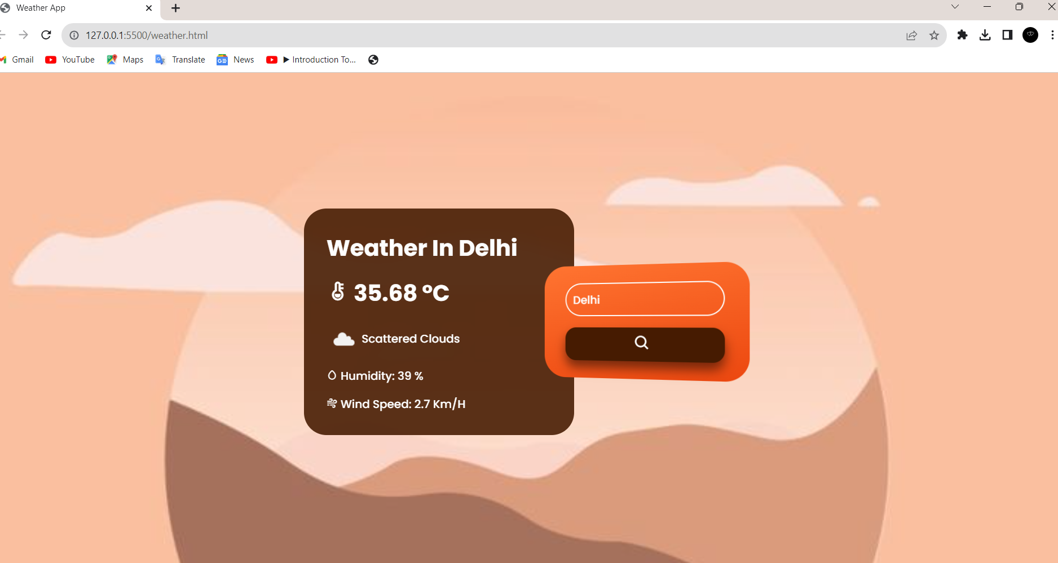
WEATHER IN DELHI

Slide 14
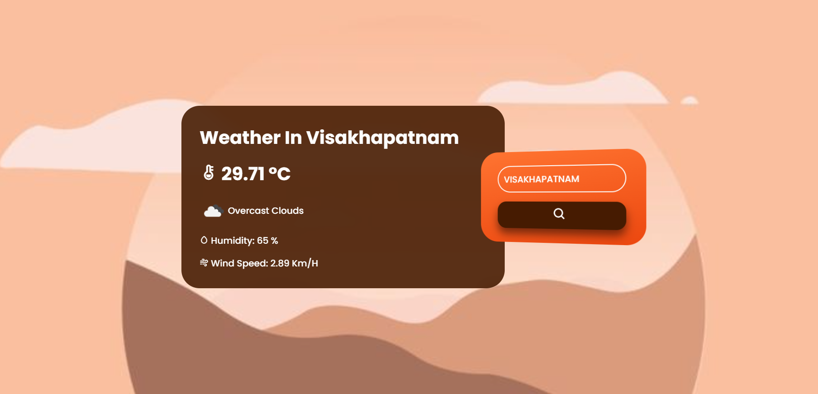
WEATHER IN VISAKHAPATNAM

Slide 15
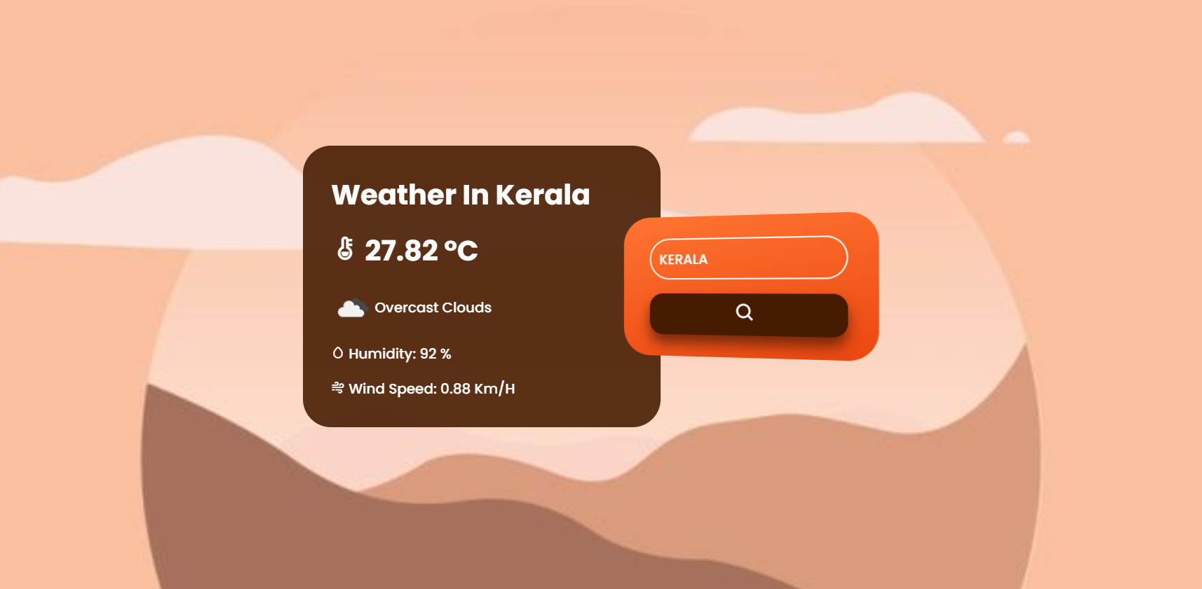
WEATHER IN KERALA

Slide 16
GITHUB LINK
https://rishithapriya.github.io/weather_forecastapp/Weather%20Forecast%20app/
https://github.com/RishithaPriya/weather_forecastapp

Slide 17


